Slide 1
Welcome to MY Presentation

Slide 2
Supervised By
Dr. Tania Islam
Assistant Professor
Department Of Computer Science And Engineering
University Of Barishal

Slide 3
PREPARED By: Md. Atiqur Rahman Batch: 65; Roll: 25 EDGE: BU-CSE Digital Skill Training Computer Fundamentals & Office Application

Slide 4
Presentation topic Foreign Exchange Operation of Government Bank

Slide 5
Introduction Banking is one of the most important sectors for country’s wealth building activities. Commercial banks are certainly profit-making Financial Institutions. These institutions play great role in the money market of every economy. Due to globalization, technological innovation and deregulation the banking system all over the world has been changing rapidly. Now a day’s banks have to compete in the market place not only with local institutions but also with foreign financial institutions.

Slide 6
selecting visual aids
Objectives of the study
The general objective of the study is to gather practical knowledge regarding banking system and operation. The practical orientation gives us a chance to co-ordinate out theoretical knowledge with the practical experience. This consists the following:
To get an overall idea about the foreign exchange Business of Sonali Bank PLC.
To apply theoretical knowledge in the practical field.
To describe the organizational structure, management, background, functions and objectives of the bank and its contribution to the national economy.
To achieve overall understanding of Sonali Bank PLC.

Slide 7
effective delivery techniques
Methodology of the study
The report is prepared on the basic of foreign Exchange Management of Sonali Bank PLC. To conduct the overall study, at first, I explored the sources of primary and Secondary information and data. Different files of the department and statement prepared by FED helped me to prepare this report. I have interviewed the SB officials for getting more information. To present numerical data, I used the Annual Report of 2023 and monthly statement of November 2020 of Sonali Bank PLC of Head office, Local branch. For preparing this report I have used some graphical representation to find out different types of analytical and interpretation.

Slide 8
Sources of data: As mentioned earlier, mainly primary data has been used. Sometimes the customers gave some important information regarding the services of the Bank
Primary Data:
Official records of Sonali Bank Limited (SB PLC).
Face to face conversation with the officer.
Direct observation.
Face to face conversation with the client.
Expert opinion.
Secondary Data:
Monthly Statement of SB PLC.
Annual Report of SB PLC.
Working Papers.
Official Files.
Selected books.

Slide 9
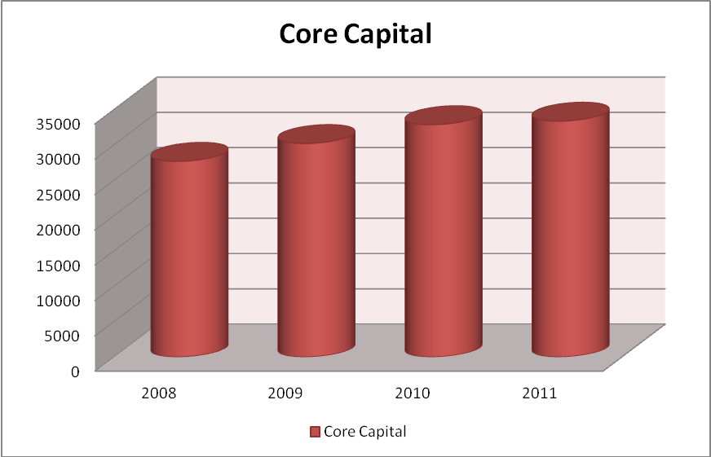
2020 2021 2022 2023

Slide 10
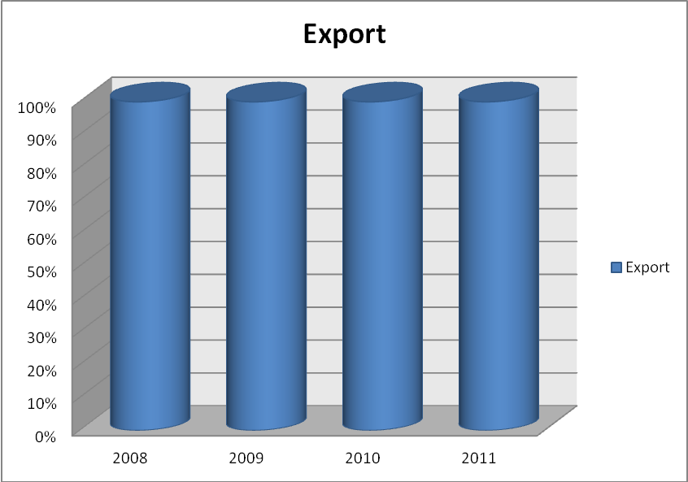
speaking impact

Slide 11
Business Position at a Glance
Sl. | Particulars | Position as on Sept., 2022 | Position as on Dec. 31, 2022 | Target 2023 | Position as on Sept., 2023
1 | 2 | 3 | 4 | 5 | 6
01. | Deposit | 29656.85 | 32899.72 | 35250.00 | 33395.94
02. | Loans & Advances | 24451.58 | 20634.76 | 21515.00 | 22823.69
03 | Classified Loans & Advances | 7073.32 | 92.1.35 | - | 8094.29
04. | % of Classified Loans to Total Advances | 28.93% | 44.59% | - | 35.46%
05. | Recovery of Classified Loans | 591.28 | 1007.55 | 2747.12 | 1025.41

Slide 12
Foreign Exchange Business
Introduction:
Commercially banks deals with both internal and foreign correspondence. The foreign correspondences are conducted through foreign currency and the department dealing with these businesses is called foreign exchange department.
Sonali Bank's expertise in International Banking has a record of in-house growth over more than half a century. Its pioneer role in handling foreign trade and foreign exchange transactions ever before independence of the country still remains unchallenged. With wide network of branches at home and also a large number of correspondent banks worldwide it is singularly handling the largest volume of export-import business including homebound remittances.

Slide 13
thank you
Foreign Trade Finance:
The total foreign exchange business of the Bank for the year 2023 was Tk. 1660.92 crore as against Tk. 16054.18 crore in 2022 showing an increase of 3.41%.
Comparative Position of foreign exchange business for the year 2022& 2023 are stated below: -
(Tk. in Crore)
SI. No. | Particulars | 2022 | 2023
1. | Total Import | 5294.04 | 5257.74
2. | Total Export | 4150.31 | 4790.65
3. | Inward Remittance (Including WES) | 6069.67 | 5766.15
4. | Outward Remittance (Including WES) | 540.16 | 787.38
 | Total | 16054.18 | 16601.92

Slide 14
RECOMMENDATIONS:
Since Sonali Bank is the leading nationalized commercial Bank of Bangladesh, it must have to remove its limitation in banking service. In my study I have recognized several weakness present states of Banking service (Mainly cash credit) and my recommendation are given below:
Process and procedures of lending should be liberalized keeping in view the problems and constraints faced by the borrower or intending borrowers.
Advance officer of the branch should be provided with training facilities and necessary incentives to ensure proper follow-up and timely recovery of loan even separate board should be formed to carry on project feasibility study which may strengthen the better utilization of the advances, better returns to the borrowers as well as to this branch also.
Necessary guidance is to be imparted to the ways and means lending to self-reliance, this may be ensured by way of enhancing the better communication with the intending borrowers.

Slide 15
Better publicity, seminar and workshop on loan may brighten the situation highlighting the needs and problems of the people or borrower.
Public sector banks should be required and induced to expand their branch network in rural areas.
Rural finance programs should be launched by the public sector Bank at their earliest convenience.
Deposit condition of this Branch is not satisfactory. Deposit is the blood of a bank. Thus, deposit collection of this branch should be improved. The branch should take necessary actions and introduce various schemes to raise deposit.
Orientation training of the borrowers may change their mental outlook, which needs to be emphasized for the better benefits of the borrowers and the bank.

Slide 16
Conclusion:
Sonali Bank is the largest commercial bank in the country. It has 1200 branches including home and abroad. As Sonali Bank a state-owned bank, it has many limitations in policy making. But it performs many tasks to government employees. It serves as a third party to the government. Government also takes loan from this bank. Bangladesh bank implements many policies by the help of this bank. It acts as a clearing house where Bangladesh bank has no branch. It provides salary to the government officials, collects gas bill, was a bill etc. It also performs general banking, loan and credit banking; foreign exchange operation etc. at Head office, local Branch, Motijheel is one of the branches which perform all the function mentioned above. It also sells the national savings certificate. My internship is only for 72 days which is very less time to know the all function of a bank. I tried my best to know about the bank, its different functions, and its work environment. I also compare the difference between theoretical and practical knowledge. I gather some experience of the job. Sonali Bank has to replace the traditional banking by the E-banking facilities. I also suggest appointing young, energetic person as staff member.

Slide 17
THANK YOU ALL

